Slide 1
Apache Spark
Streaming

Slide 2
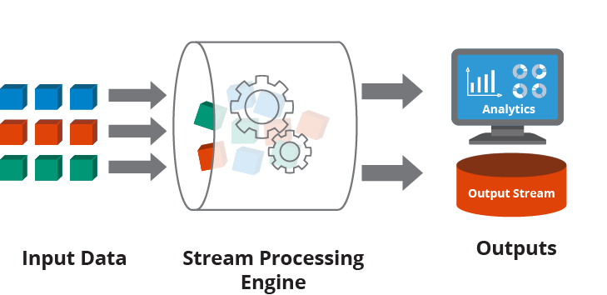
Stream processing
Is a key requirement in many big data applications.
The act of continuously incorporating new data to compute a result

Slide 3
Stream processing - Use Cases
Notifications and alerting
Real-time reporting
Online machine learning

Slide 4
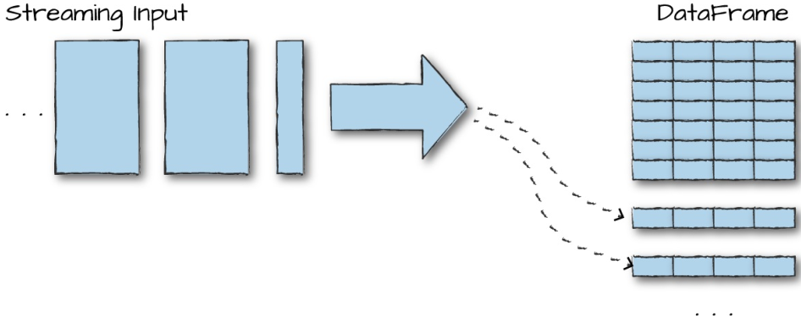
Structured Streaming Basics
To treat a stream of data as a table to which data is continuously appended
The job then periodically checks for new input data, process it, updates some internal state
In simplest terms, Structured Streaming is “your DataFrame, but streaming.”

Slide 5
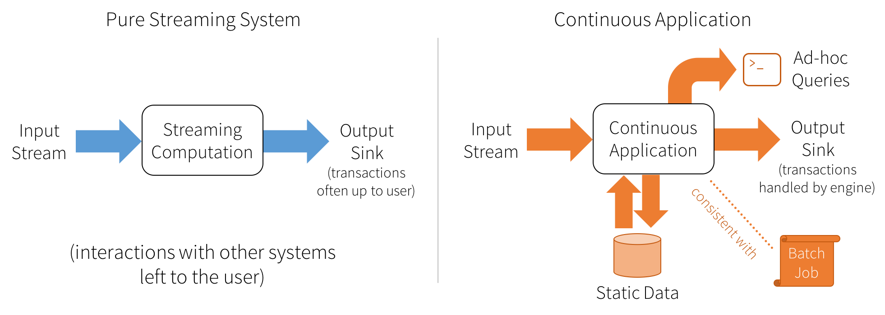
Continuous Application
Structured Streaming enables users to build
Continuous applications
Continuous application is an end-to-end application that
Reacts to data in real time

Slide 6
Core Concepts
Transformations and Actions
Maintains the same concept of transformations and actions
Input Sources
Apache Kafka
Files on a distributed file system like HDFS or S3
Sinks
Apache Kafka
Almost any file format
A console sink for testing
A memory sink for debugging

Slide 7
Core Concepts
Output Modes
Append (only add new records to the output sink)
Update (update changed records in place)
Complete (rewrite the full output)
Triggers
Define when data is output
By default will look for new input records as soon as it has finished processing the last group of input data
Also supports triggers based on fixed interval

Slide 8
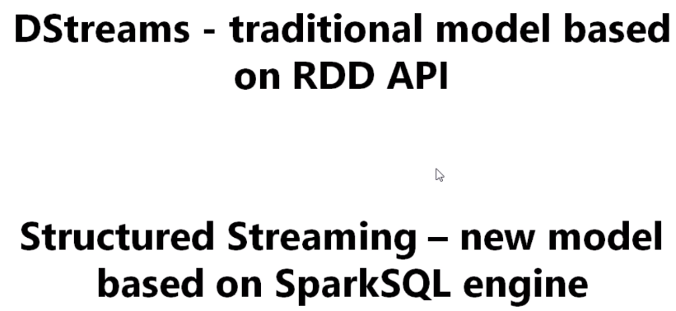
2 Versions of Streaming

Slide 9
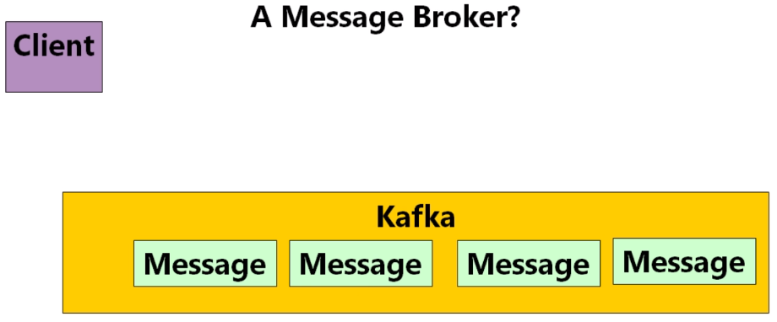
What is Kafka?

Slide 10
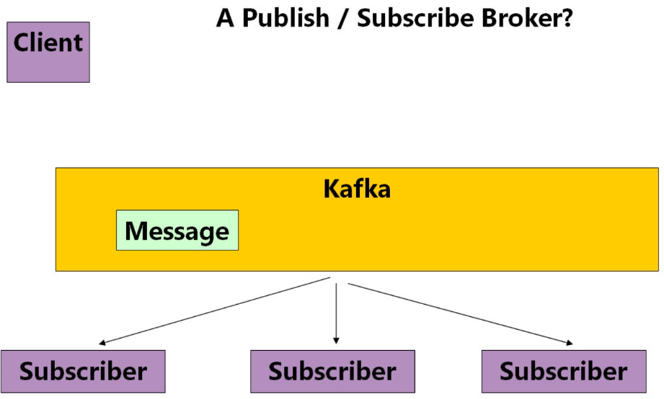
What is Kafka?

Slide 11
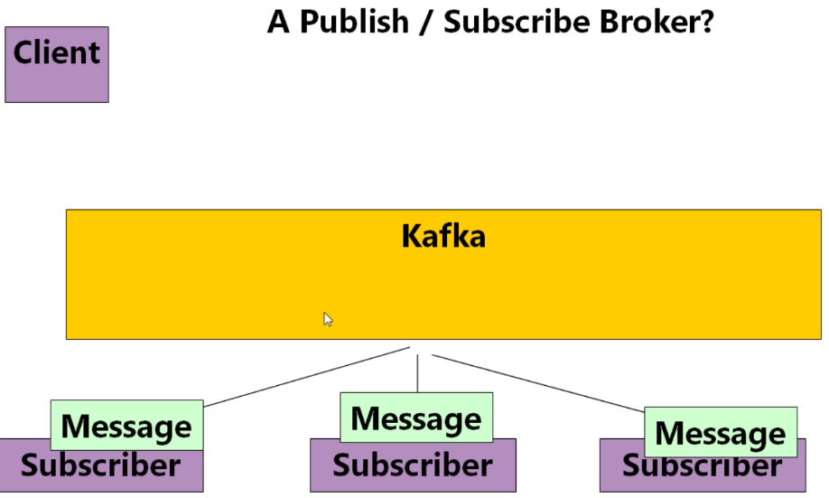
What is Kafka?

Slide 12
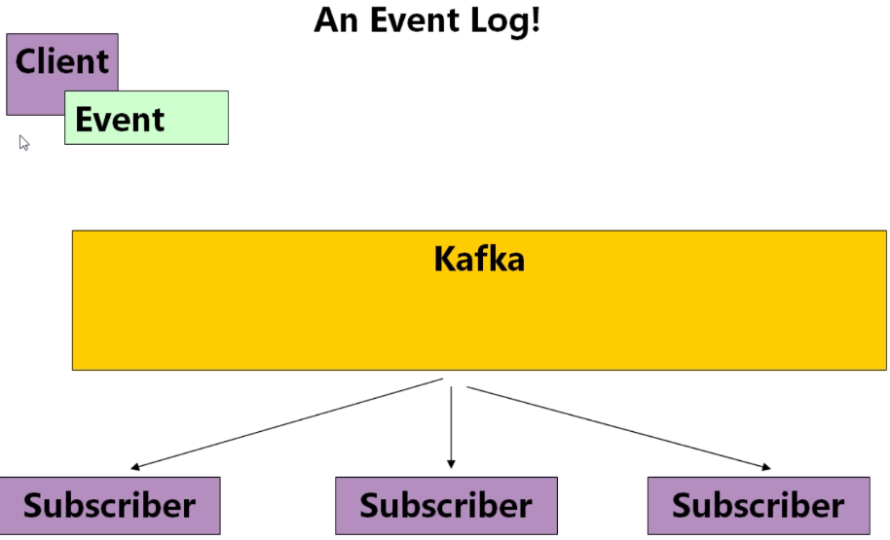
What is Kafka?

Slide 13
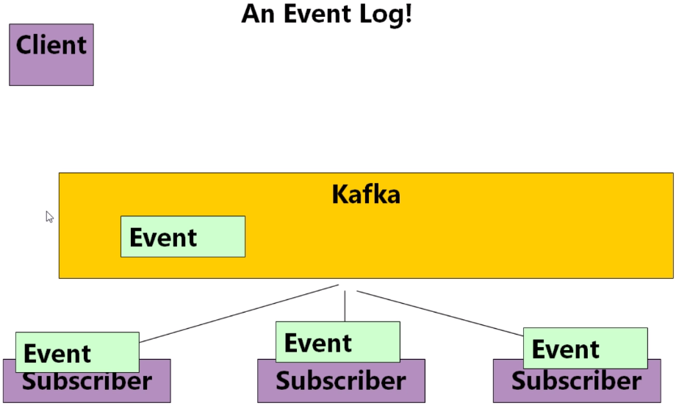
What is Kafka?

Slide 14
Kafka is
A distributed Event Ledger / Log
This makes it perfect for streaming applications

Slide 15
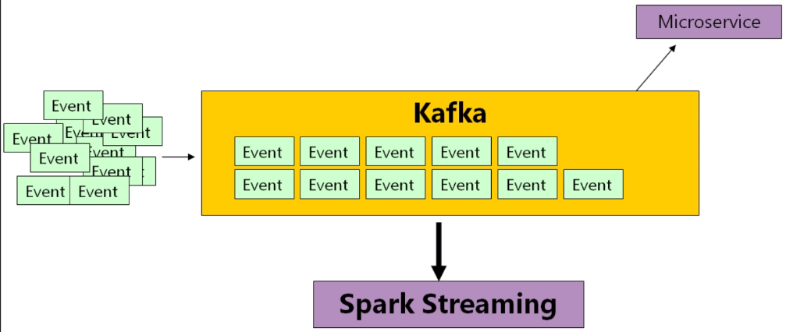
Kafka for Streaming

Slide 16
Install Kafka
Refer:
https://kafka.apache.org/quickstart
wget https://apachemirror.wuchna.com/kafka/2.8.0/kafka_2.13-2.8.0.tgz
tar -xzf kafka_2.13-2.8.0.tgz
cd kafka_2.13-2.8.0
bin/zookeeper-server-start.sh config/zookeeper.properties &
bin/kafka-server-start.sh config/server.properties &
bin/kafka-console-producer.sh --topic topic1 --bootstrap-server localhost:9092
bin/kafka-console-consumer.sh --topic topic1 --from-beginning --bootstrap-server localhost:9092

Slide 17
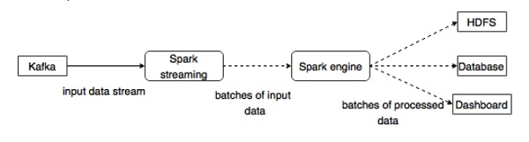
Integration with Spark

Slide 18
Hands-On: Stream Kafka events using Spark
Connect to terminal
Activate VENV
source /spark_venv_311/bin/activate
Run Kafka Producer
python ~/Python-Scala-Spark-Training/Exercises/Spark/Spark-Streaming/kafka_producer_csv.py
Open another terminal and activate VENV again
Run Kafka Consumer
python ~/Python-Scala-Spark-Training/Exercises/Spark/Spark-Streaming/kafka_streaming_csv_demo.py
Notes:
nohup /kafka_2.13-2.8.0/bin/zookeeper-server-start.sh /kafka_2.13-2.8.0/config/zookeeper.properties &
nohup /kafka_2.13-2.8.0/bin/kafka-server-start.sh /kafka_2.13-2.8.0/config/server.properties &

Slide 19
Thanks

